Slide 1
A1 Chemistry
Moles, Avogadro’s number and molar mass

Slide 2
Review
Write a molecular, full ionic and net ionic equation for:
nitric acid_{(aq)}+ copper_{(s)}→ nitrogen dioxide_{(g)}+ copper II nitrate_{(aq)}+ water_{(l)}

Slide 3
How many significant figures?
000.0093732
53.000463
4631.00
46370000
487201
000.000420
Now, write each as scientific notation, 3 sig figs

Slide 4
Learning Intentions
the mole is a precisely defined quantity of matter equal to Avogadro’s number of particles
the mole concept relates mass, moles and molar mass and, with the Law of Conservation of Mass; can be used to calculate the masses of reactants and products in a chemical reaction

Slide 5
Success criteria
Present all calculations to 3sf, in scientific notation as needed
Convert between number of particles, moles and mass for compounds or elements within compounds
Explain the Law of Conservation of Mass

Slide 6
The Mole
A mole is the number of atoms which weigh the relative atomic mass of an element
ie 12 grams of carbon contains one mole of carbon atoms
OR the number of molecules which weigh the molecular weight
ie 44 grams of carbon dioxide contains one mole of carbon dioxide molecules

Slide 7
Avogadro’s Number
Avogadro’s number is the number of atoms in a mole of atoms (or of any other object for that matter)
Avogadro’s number equals 6.022 x 10²³
Technically, he didn’t figure out this number, but the idea that the number could be determined was all his!

Slide 8
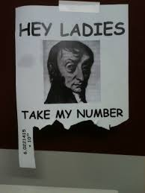

Slide 9
Avogadro’s number relates molar mass on an atomic scale to physical mass on a human scale – it puts the relative in relative atomic mass
The mole is the SI unit for quantity of ‘chemical entities’.

Slide 10
Converting from particles to moles
n = number of particles
N_{A}
6.022 x 10²³

Slide 11
Moles and mass
Molar mass (ie the mass of one mole) is the same as
the atomic mass for elements
the molecular weight for molecules
the formula weight for ionic compounds
n = m where n is number of moles
M m is mass in g
M is molar mass

Slide 12
Moles in equations
2H₂ + O₂ → 2H₂O
2 molecules of hydrogen react with 1 molecule of oxygen to produce 2 molecules of water
2 moles of hydrogen react with 1 mole of oxygen to produce 2 moles of water
4 g of hydrogen react with 32 g of oxygen to produce 36 g of water

Slide 13
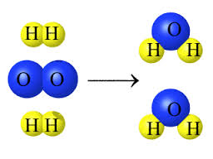
The Law of Conservation of Mass

Slide 14
Success criteria
Present all calculations to 3sf, in scientific notation as needed
Convert between number of particles, moles and mass for compounds or elements within compounds
Explain the Law of Conservation of Mass

